Slide 1
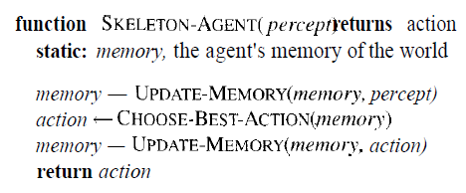
Agent programs
All agent programs have same skeleton, namely, accepting percepts from an environment and generating actions.
There are two things to note about this skeleton program:
agent program receives only a single percept as its input
the goal or performance measure of agent is not its part.

Slide 2
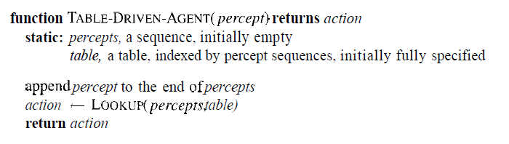
Why not just look up the answers?
It operates by keeping in memory its entire percept sequence, and using it to index into table, which contains the appropriate action for all possible percept sequences.

Slide 3
Proposal failed !
The table needed for agents will have large entries.
It would take quite a long time for the designer to build the table.
The agent has no autonomy at all, because the calculation of best actions is entirely based on built-in knowledge.
Even if we gave the agent a learning mechanism as well, so that it could have a degree of autonomy, it would take forever to learn the right value for all the table entries.

Slide 4
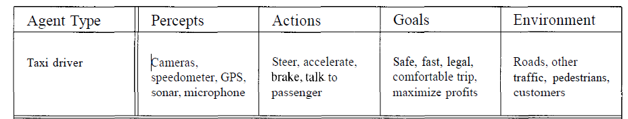
Example: Taxi driver agent.
Performance measure:
getting to the correct destination
minimizing fuel consumption and wear and tear (damage that naturally occurs due to aging.
minimizing the trip time and/or cost
minimizing violations of traffic laws and disturbances to other drivers
maximizing safety and passenger comfort
maximizing profits.

Slide 5
We have to decide how to build a real program to implement the mapping from percepts to action.
Four types of agent program:
• Simple reflex agents
• Agents that keep track of the world
• Goal-based agents
• Utility-based agents

Slide 6
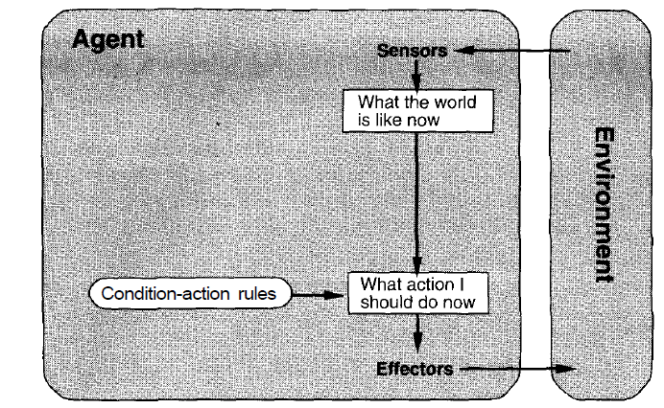
Simple reflex agents
:
condition-action rule
if car-in-front-is-braking then initiate-braking

Slide 7
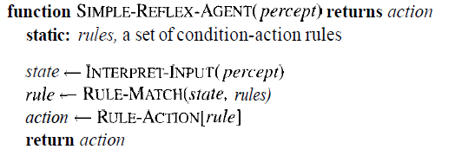
A simple reflex agent works by finding a rule whose condition matches the current situation (as defined by the percept) and then doing the action associated with that rule.

